Slide 1
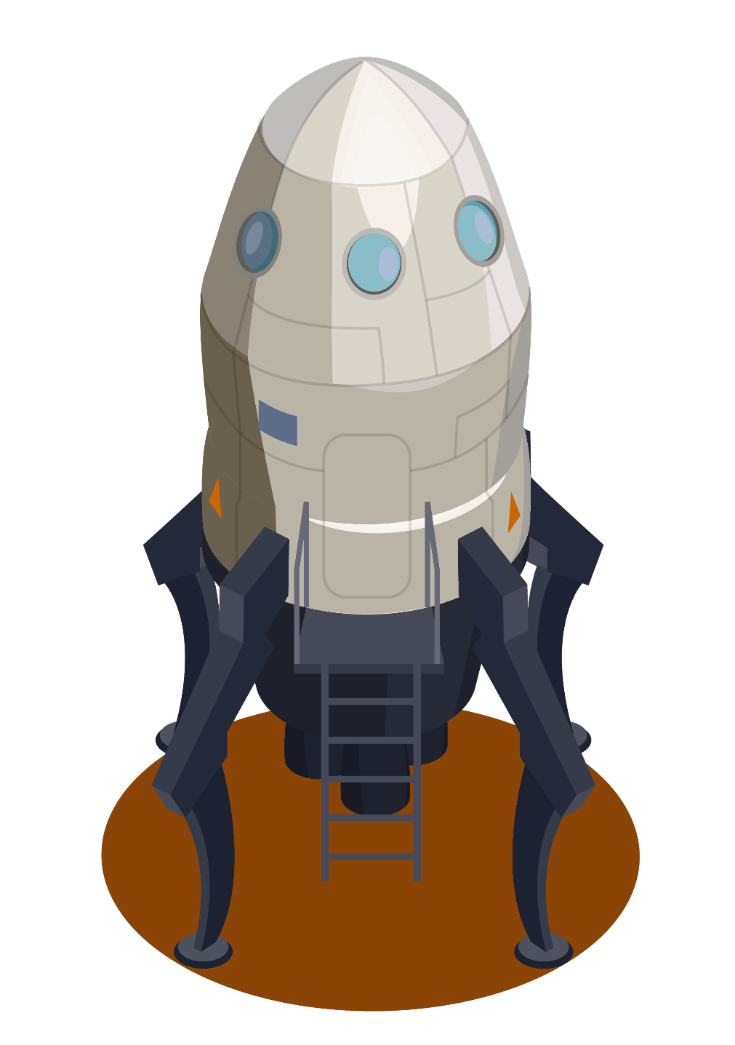
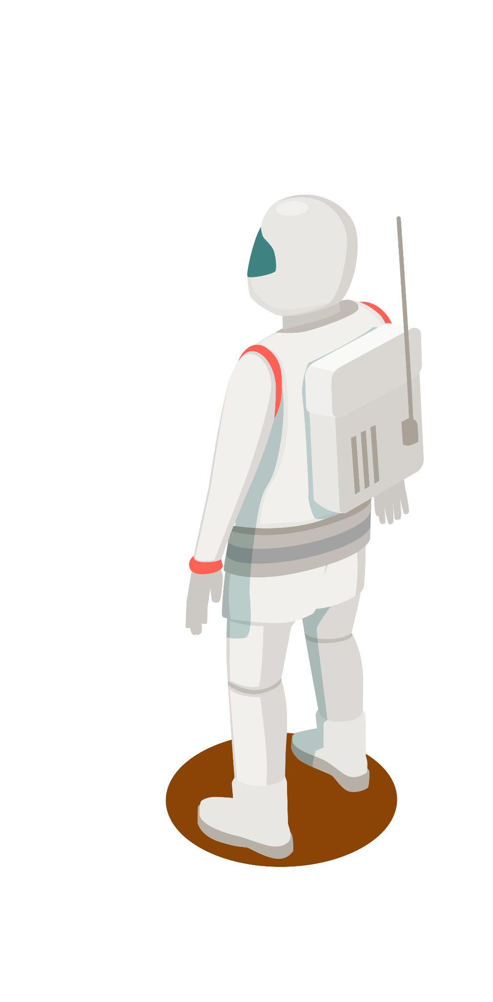
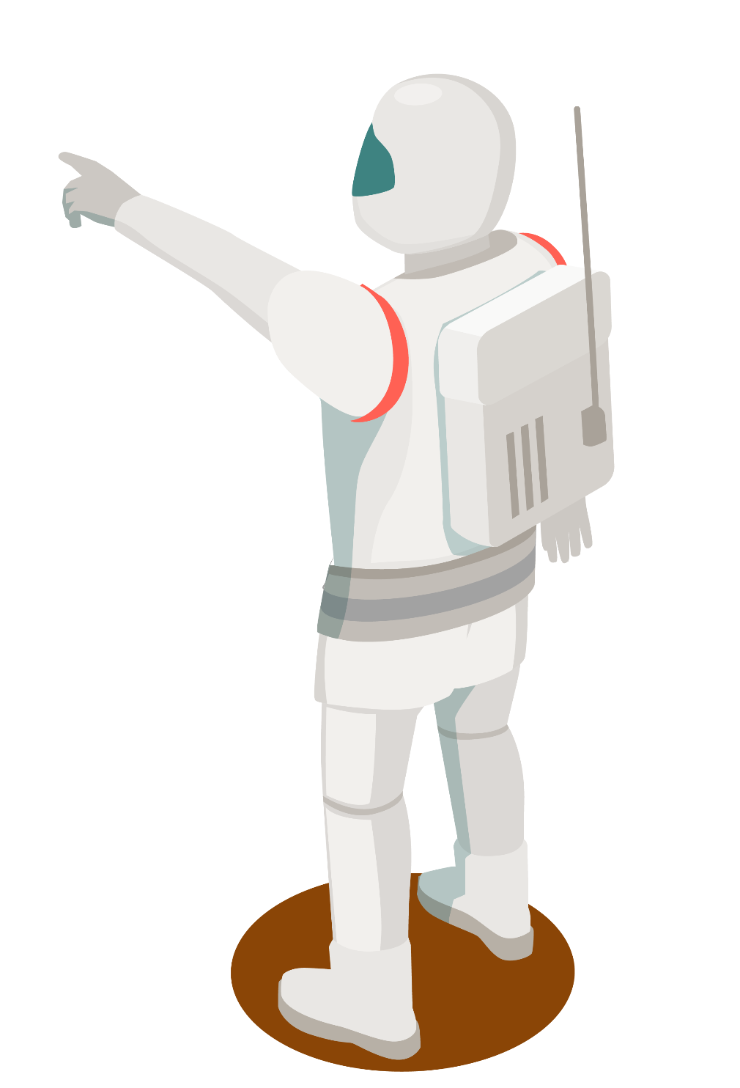
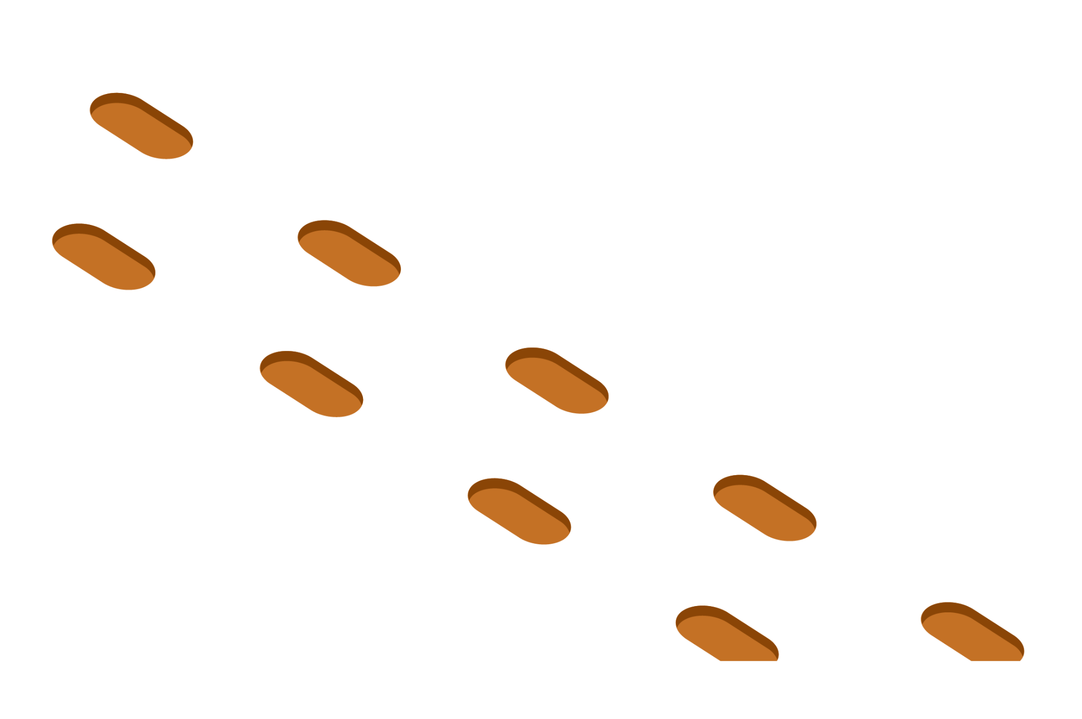
CU Rover Robotic Arm
Michael DeCapua
Alex Klausenstock
Subhraneel Sarkar
Monique Reid

Slide 2
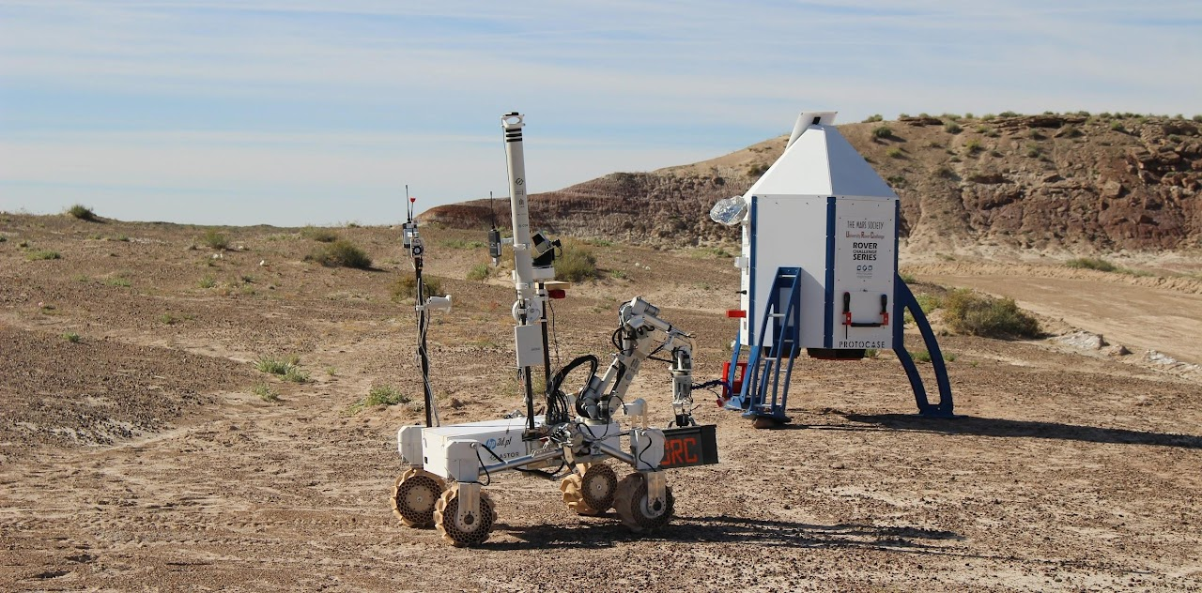
What is the University Rover Challenge?
A robotics challenge taken on by the CU Rover Team
This challenge models multiple space missions for the current Mars Rover to complete.
Reference: https://urc.marssociety.org/
Notes:
Mike

Slide 3
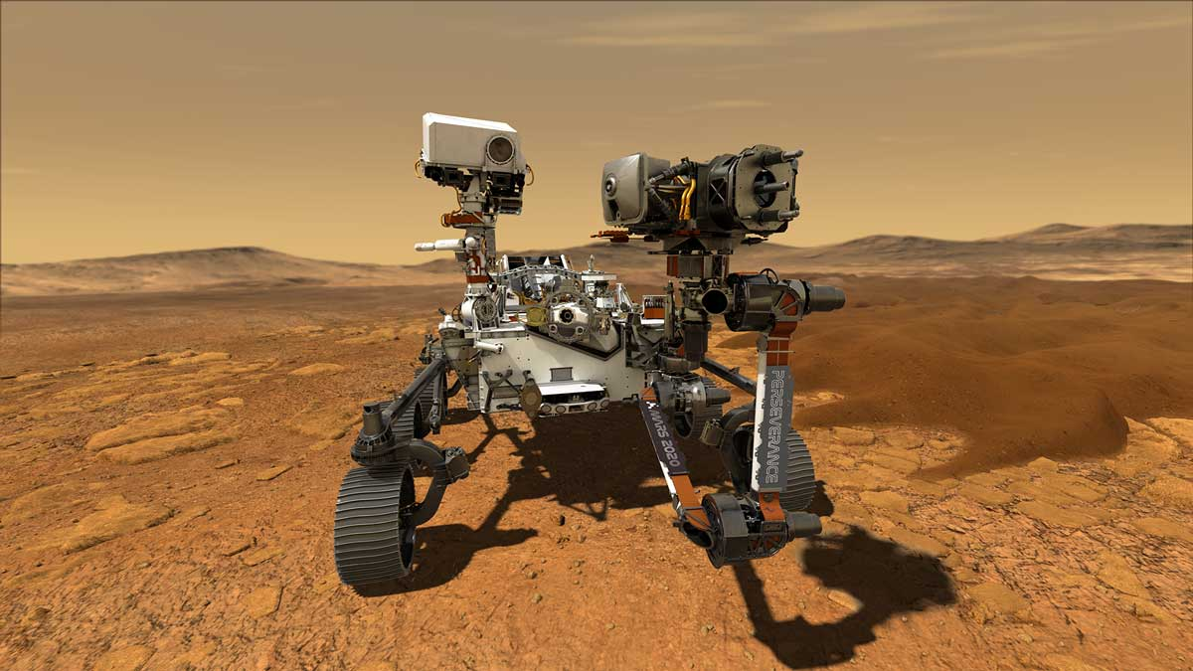
How can we complete physical tasks on Mars?
The answer is: Robotics.
Mechanical systems in space will needed to understand the properties of other planets.
In this analysis we will be evaluating the manufacturability of a robotic arm.
Reference: https://mars.nasa.gov/mars2020/
Notes:
Mike

Slide 4
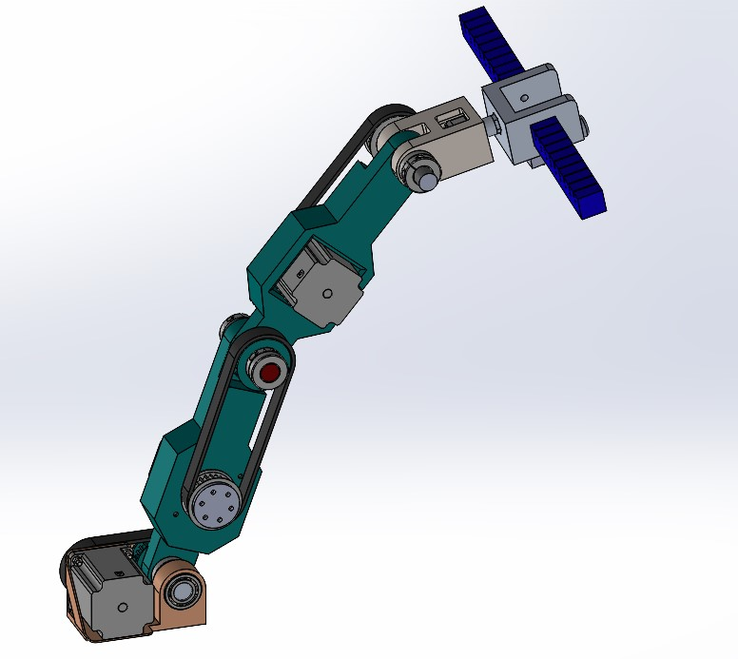
Introduction to the Robotic Arm
Four axis of rotation on this robotic manipulator
Base
Linkage Assembly
Wrist
Gripper
Soft robotic gripper for fragile objects
Four stepper motors
Total weight: 38 lb (17.24 kg)
Total length extended: 35 in (0.89 m)
Notes:
MIKE

Slide 5
What are our design objectives?
A light weight and cost effective robotic arm.
Simplified assembly of a robotic arm.
To develop a mechanical system for future citizens of Mars could purchase to understand and study their new planet.
Reference: Marvin the Martian
Notes:
Mike

Slide 6
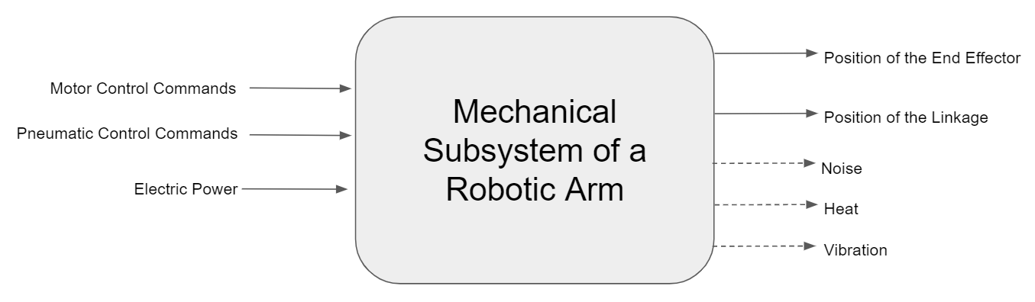
Black Box Diagram
Notes:
Monique

Slide 7
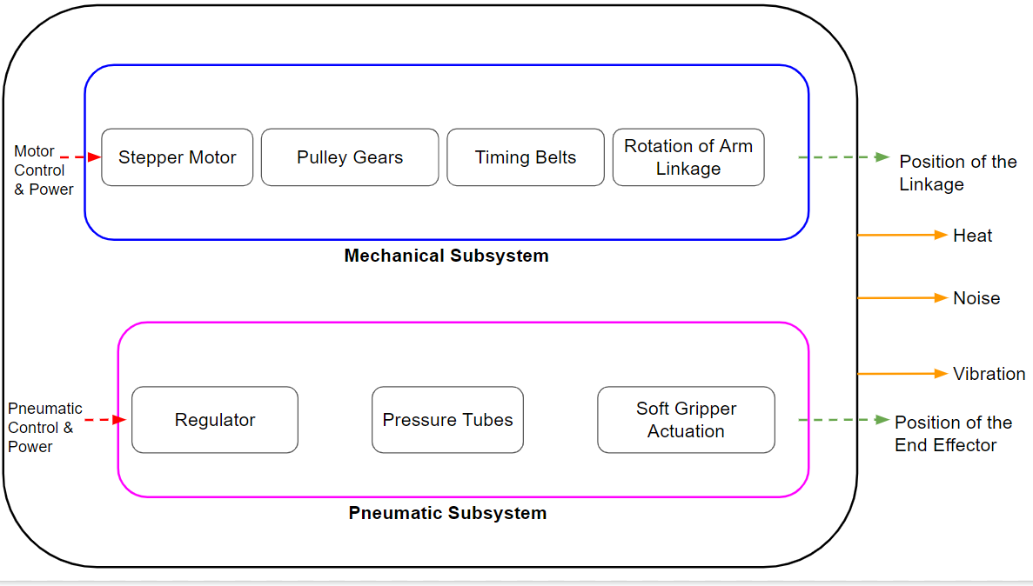
Glassbox diagram
Notes:
Monique

Slide 8
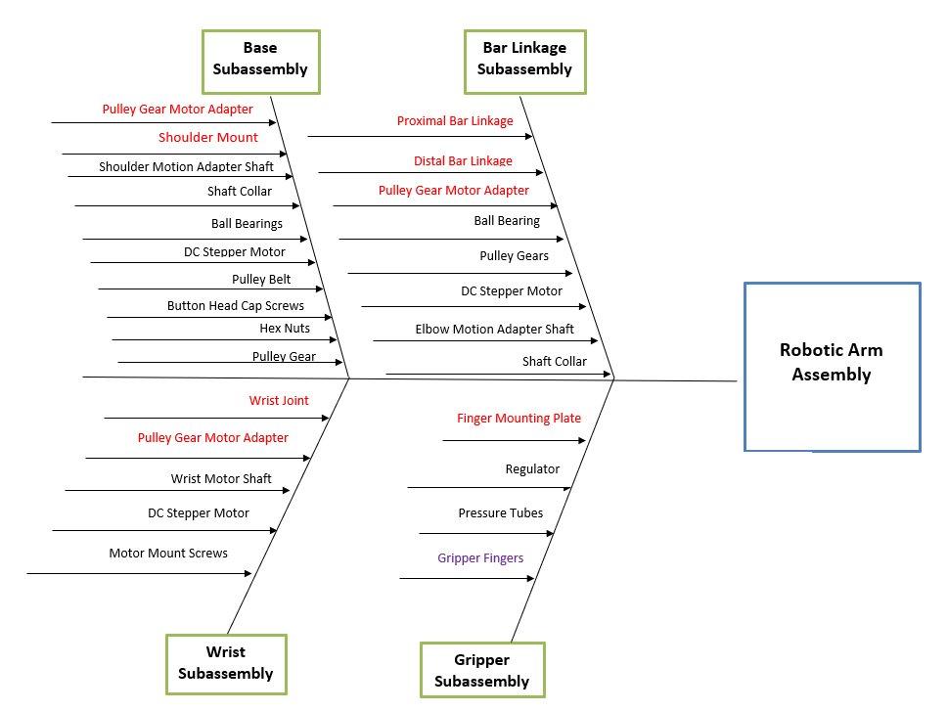
Fishbone diagram
Notes:
Monique

Slide 9
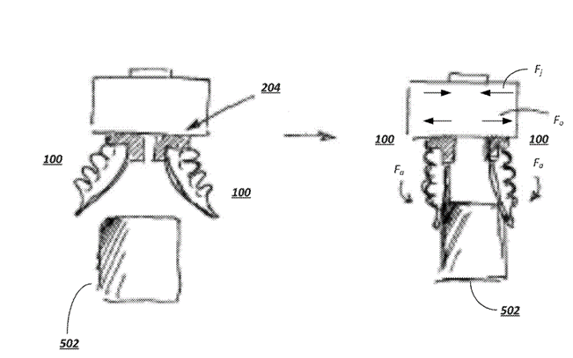
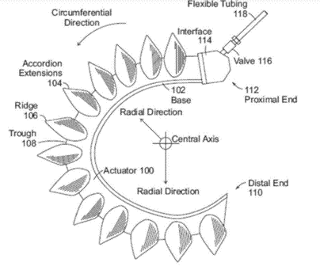
Patent Search
Has a gripper hub and a finger actuator that applies pressure change
Include an elastomeric outer surface surrounding an internal void, and each is configured to curl when there is a pressure change in the finger
This actuator has high behavioral diversity, large degrees of freedom, continuum topology and low weight
This makes grasping more :
Robust
Inherently compliant
Inexpensive
US 11,045,959 B2
Notes:
Ron

Slide 10
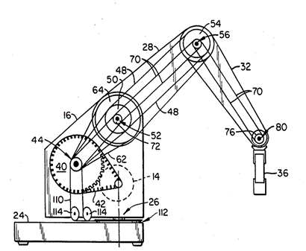
This patent includes a system where each structural member is pivotally coupled with each other to form joints and are controlled by motors
Position calibration is done via drive arrangements through cable/pulley systems
Provides an apparatus for securing and routing various drive cables to the pulley structures so that a more positive coupling between the motors and the structural members can be obtained.
US #4,806,066
Notes:
Ron

Slide 11
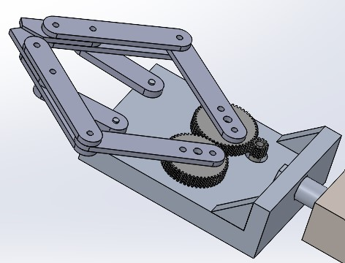
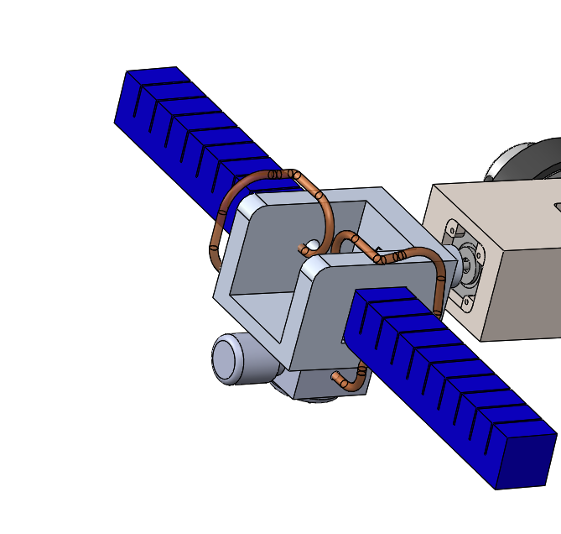
REDESIGN: Part Count Reduction (Gripper)
Grasp fragile objects
Robust and inherently compliant Gripper
Low weight
Easily 3D printed, inexpensive
Reducing part count
Motors
Extra links
Notes:
Mike

Slide 12
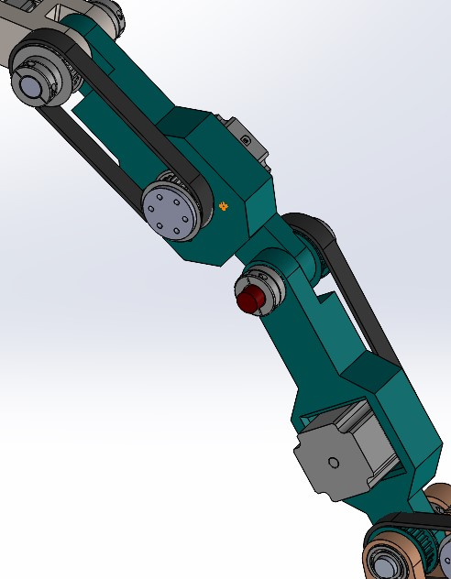
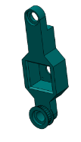
REDESIGN: Arm Linkage
Changes:
Investment Cast for complex geometry
Integrated Pulley Gears /eliminated screws/internal features
Added bearing pockets
Added Stepper motor mount with self locating feature
Notes:
Alex

Slide 13
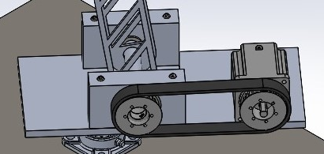
REDESIGN: Shoulder Mount
Changes:
Investment Cast for complex geometry
Integrated bearing mounts
Integrated stepper motor mount w/ self locating feature
Notes:
Alex

Slide 14
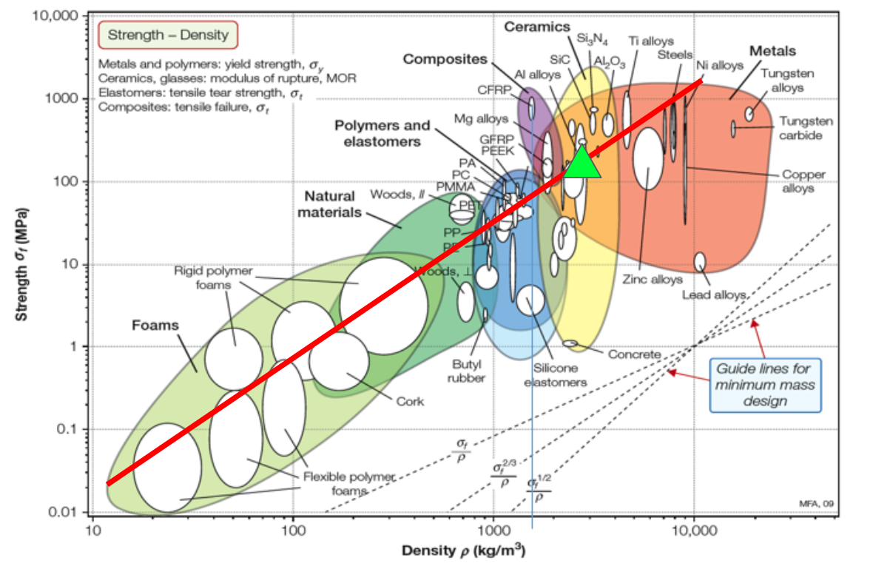
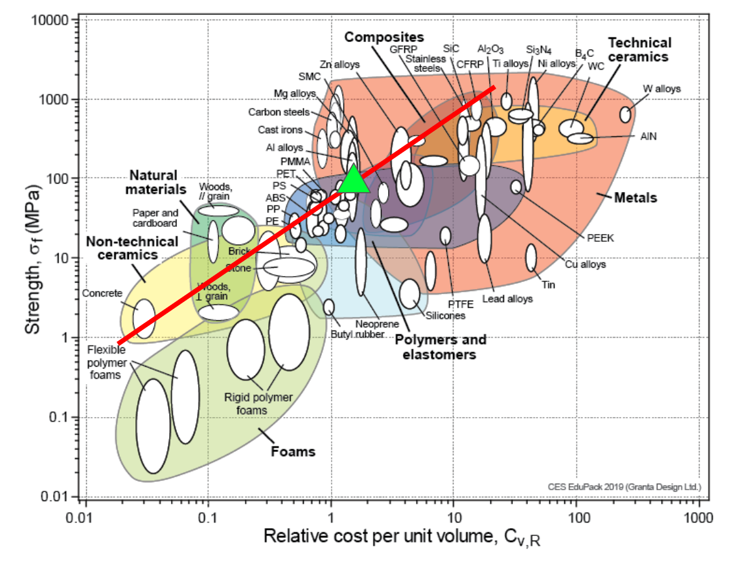
Material Analysis Structural Components
Aluminum:
Strong & Light
Manufacturable
Affordable for Strength
Notes:
Alex

Slide 15
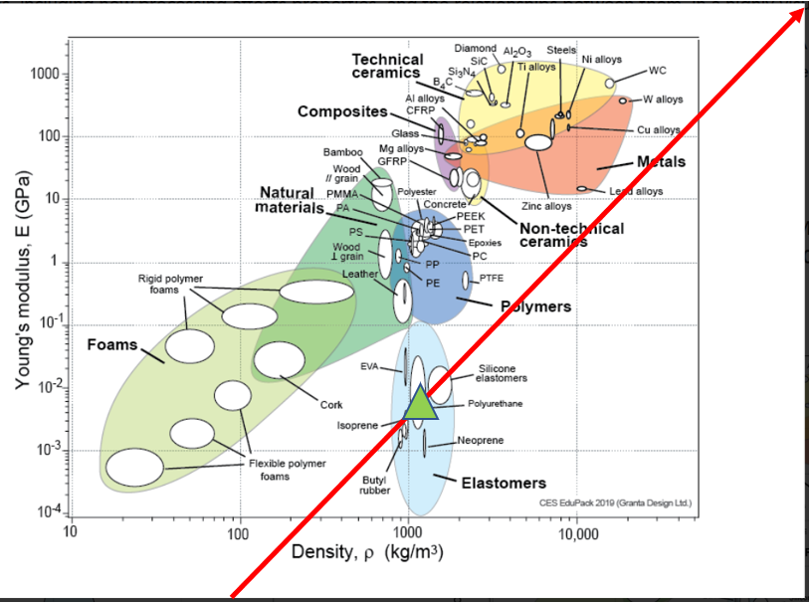
Material Analysis Flexible Gripper
TPU (NinjaFlex)
Combines high strain and correspondingly high stress (up to 80-150 MPa) with low density (1.005g/cm3)
Can lift and grasp high payloads of 5-7kg
Notes:
Ron

Slide 16
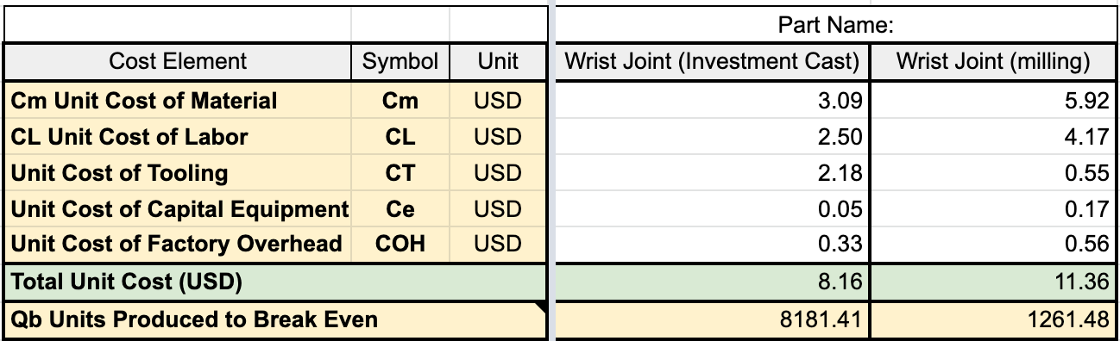
Economic Analysis Process Comparison
100,000 Units!
Unit Cost Down
Qb Up
Material & Labor Down
New
Old
Notes:
Alex

Slide 17
Economic Analysis Comparison Summary
Old
New
28% Less Expensive!
Notes:
Alex Part count decrease, part integration/ reduction especially in gripper Less Purchased parts!

Slide 18
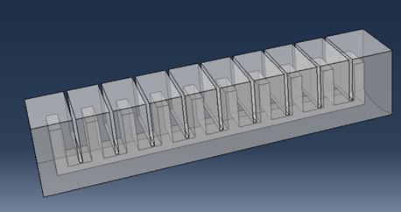
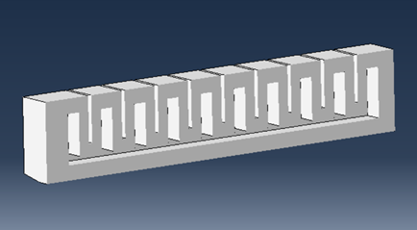
FEA
10 inner gas gas chambers connected via one channel
Yeoh hyperelastic model for TPU
Meshing done using Tet elements in ABAQUS CAE
Notes:
Ron

Slide 19
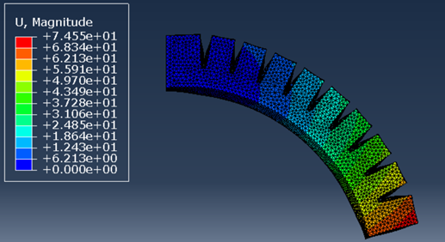
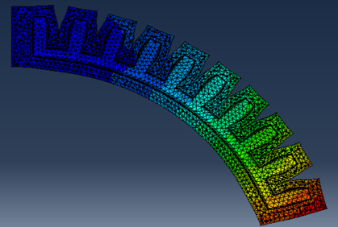
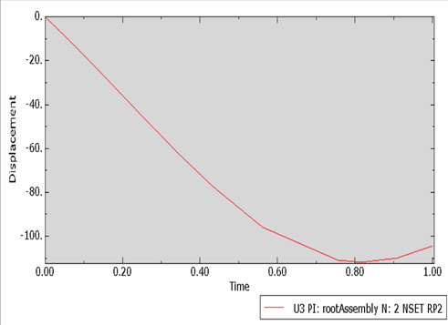
Bending increase with increase in pressure and actuator bends in a circular trajectory
From the angular displacement v time curve, we can see that it non linearly increases and after a certain saturation point increases again as the actuator hits the semi circle
Notes:
Ron

Slide 20
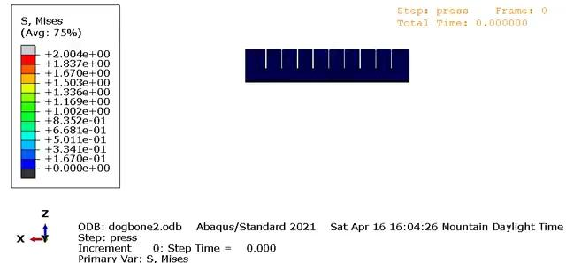
Notes:
Ron

Slide 21
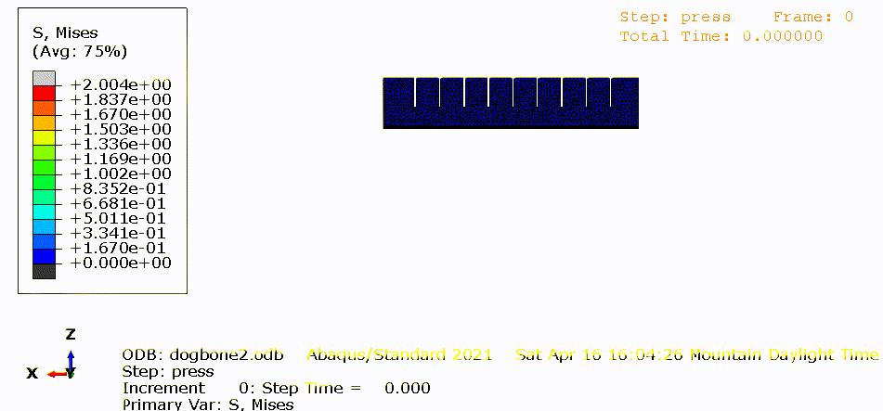

Slide 22
DFA Complexity
Delta (Δ) = -4.97
Goals:
Reveal opportunity to minimize the number of extraneous or unnecessary parts
Standardize where possible
Simplify assembly for manufacturer
Outcomes:
Reduced number of hardware parts by 10
Increased number of interfaces in the proximal bar linkage and shoulder mount
Gripper assembly reduced from 26 to 5 parts
V1
Final
Notes:
Monique

Slide 23
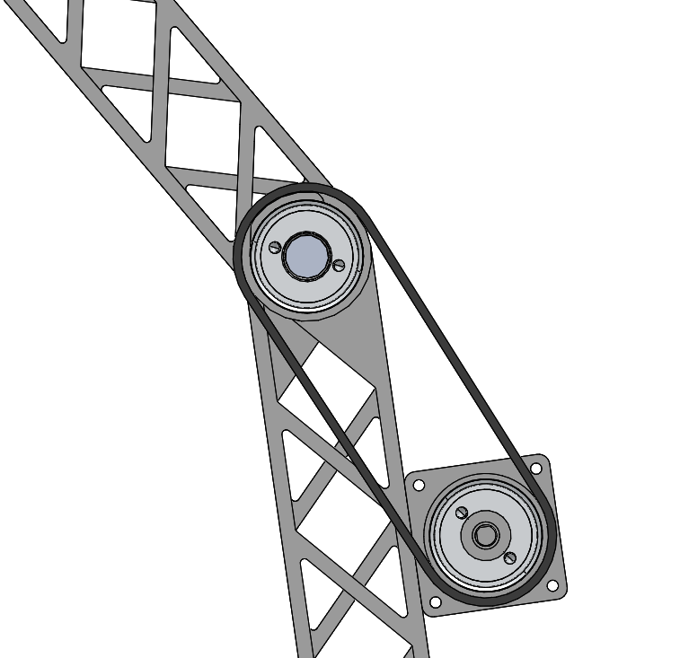
Theoretical & Practical Efficiency
Delta (Δ) = + 11.5%
Delta (Δ) = + 16.7%
Goals:
Standardize and evaluate the utility of each part
Determine the minimum number of theoretical and practical parts
Optimize the functionality of each part
Outcomes:
Number of hardware parts remained roughly the same
Combined bar linkage and pulley gear (2 less parts)
Final
V1
Double 2 Bar Linkage with Attached Pulley
2 Bar Linkage
with Merged Pulley
Notes:
Monique

Slide 24
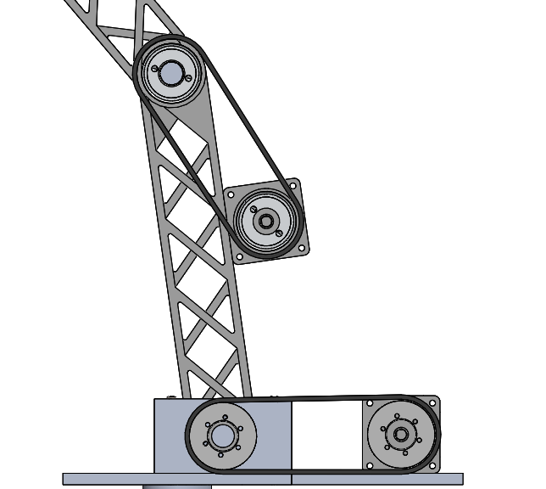
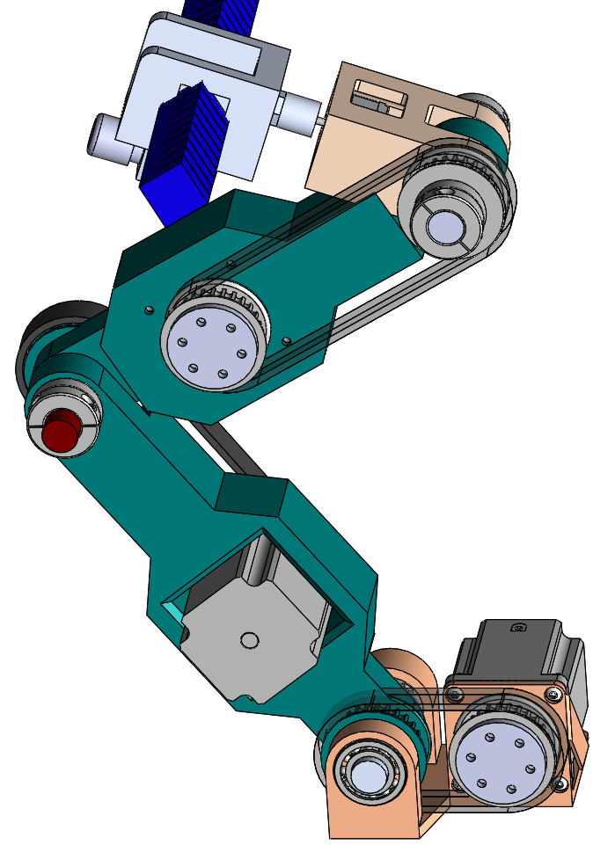
Error Proofing
Delta (Δ) = - 0.42
Goals:
Improve ease of assembly
Prevent incorrect orientation of components
Prevent missing components
Outcomes:
Reduced number of parts in the gripper assembly
Standardize gears throughout assembly
Reduce complexity of parts
Two Different Gears
Standardize Gears
V1
Final
Notes:
Monique

Slide 25
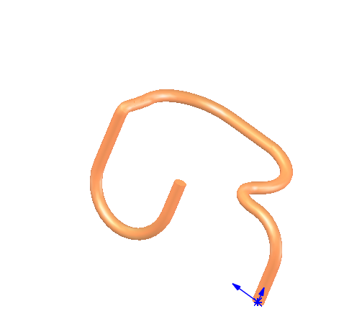
Handling
Delta (Δ) = +0.05
Goals:
Prevent difficulty for manufacturer to assemble
Remove any hazards when handling the components
Outcomes:
Initial design components were pretty robust
Only change was a result of adding the pressure tubes
Depending on thick the tube design will be varies the stiffness
Final
Notes:
Monique

Slide 26
Insertion
Delta (Δ) = -0.46
Goals:
Prevent difficulty in alignment
Prevent additional steps or effort to hold down assembly
Prevent obstruction to key features
Outcomes:
More compact finger actuation system
Motor pockets inside the shaft and wrist joint
Final
Self-Locating Feature
Notes:
Monique

Slide 27
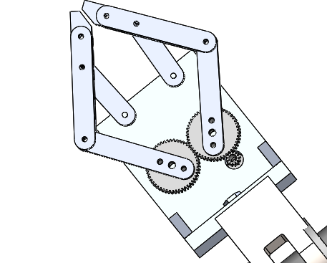
Secondary Operations
Delta (Δ) = -0.25
Goals:
Reduce number of reorientations
Reduce secondary screwing, adhesive, etc. operations
Keep system simple- prevent needing to test, measure, or adjust
Outcomes:
Reduced number of screw operations at the gripper assembly
Did add several adhesive steps for the regulator and finger actuators
Reduced number of secondary operations for securing stepper motors
Final
V1
Notes:
Monique

Slide 28
DFA Analysis and Comparison
DFA Metrics | Original | Revised | Delta (Δ) | Improvement?
DFA Complexity | 80.28 | 75.31 | -4.97
Theoretical Efficiency (%) | 29.2% | 39.6% | + 11.5%
Practical Efficiency (%) | 27.7% | 43.4% | +16.7%
Error Proofing | 0.47 | 0.05 | -0.42
Handling | 0.00 | 0.05 | +0.05
Insertion | 1.32 | 0.86 | -0.46
Secondary Operations | 0.63 | 0.38 | -0.25
Notes:
Monique

Slide 29
Conclusion and Final Thoughts
This assembly has decreased in complexity and increased cost effectiveness.
DFA Complexity decreased by 4.97 points
Unit Price has decreased by $216.75
Going forward..
This assembly will be prototyped and tested in Summer 2022 by the CU Rover Team.
Notes:
Mike

Slide 30
Thank You!

Slide 31
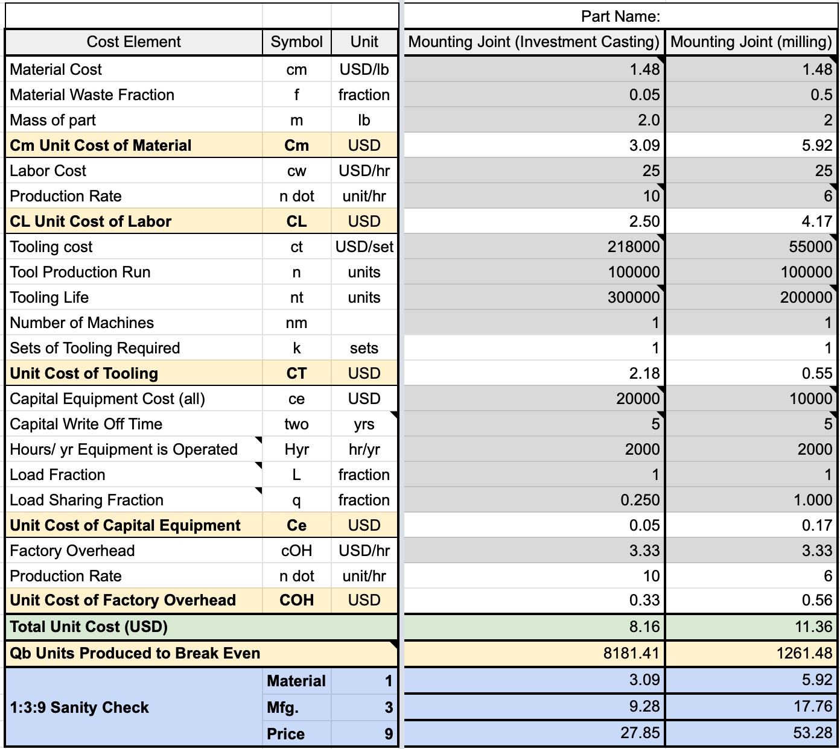
Appendix Eco Process Comparison

Slide 32
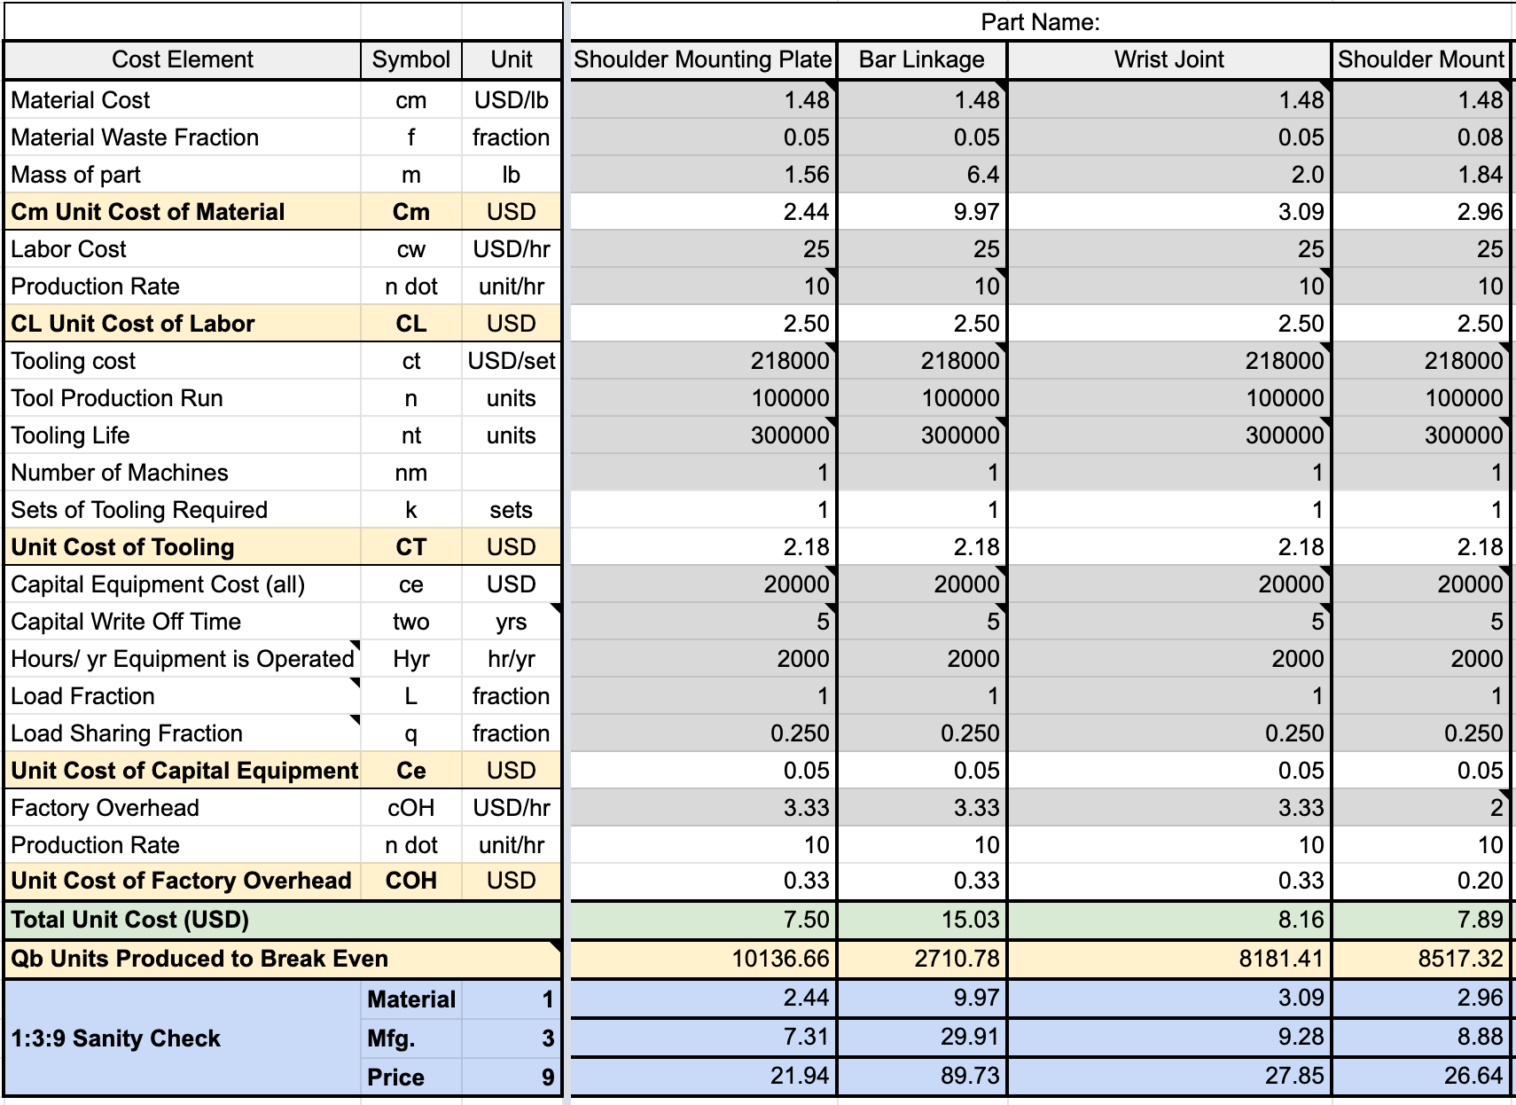
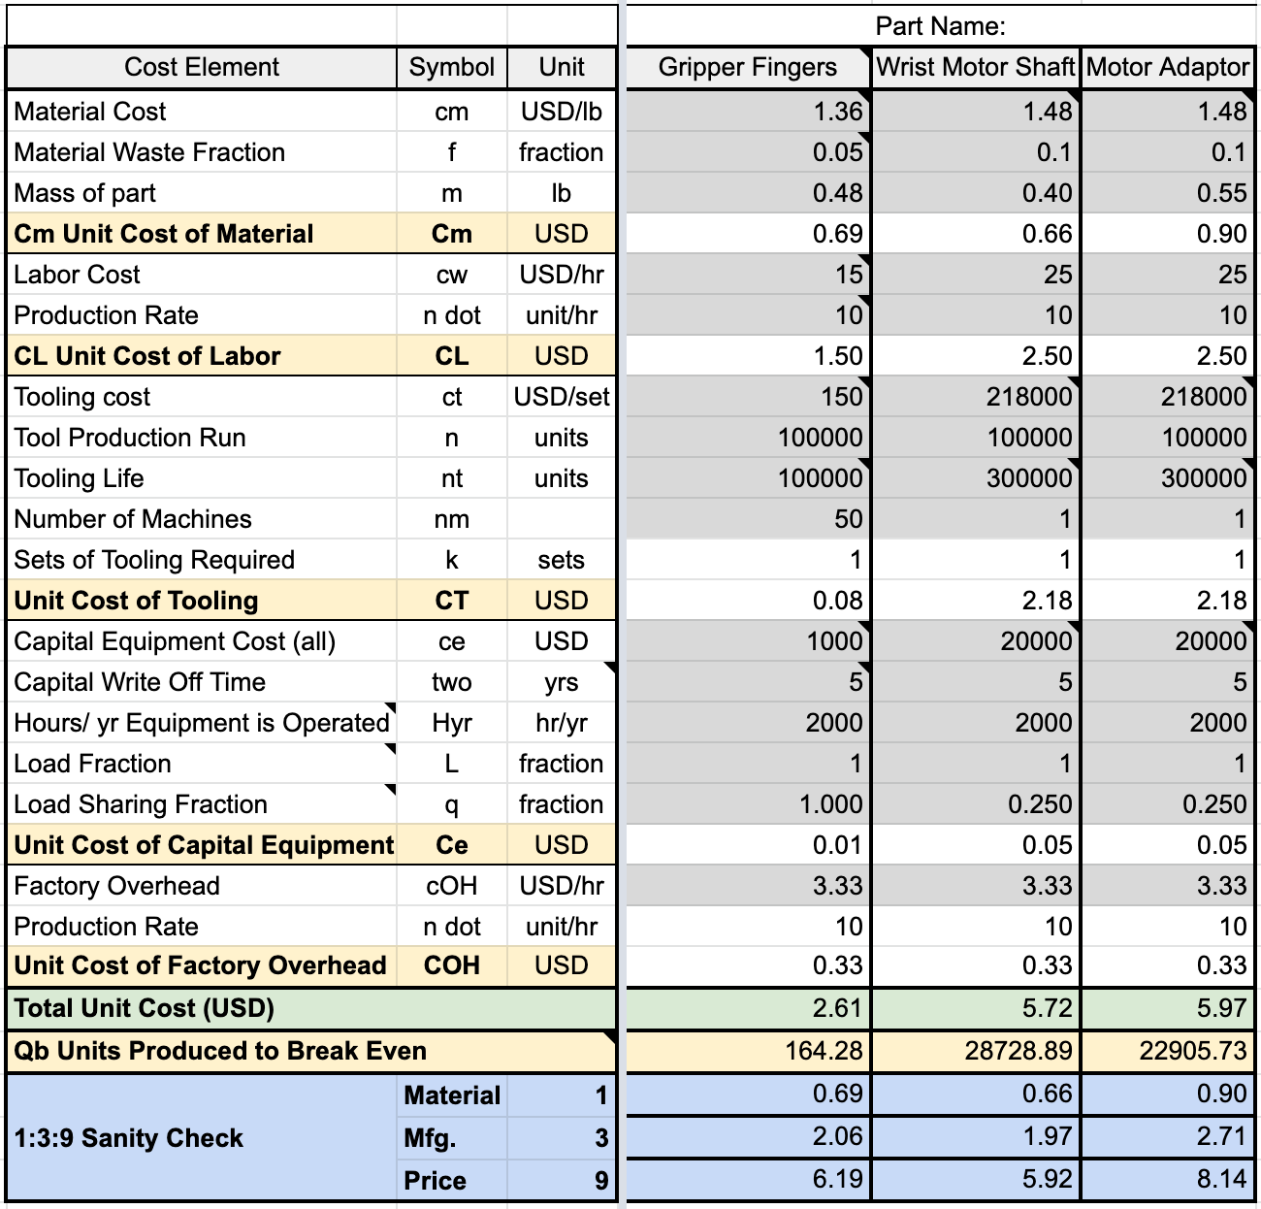
Appendix redesign economic analysis

Slide 33
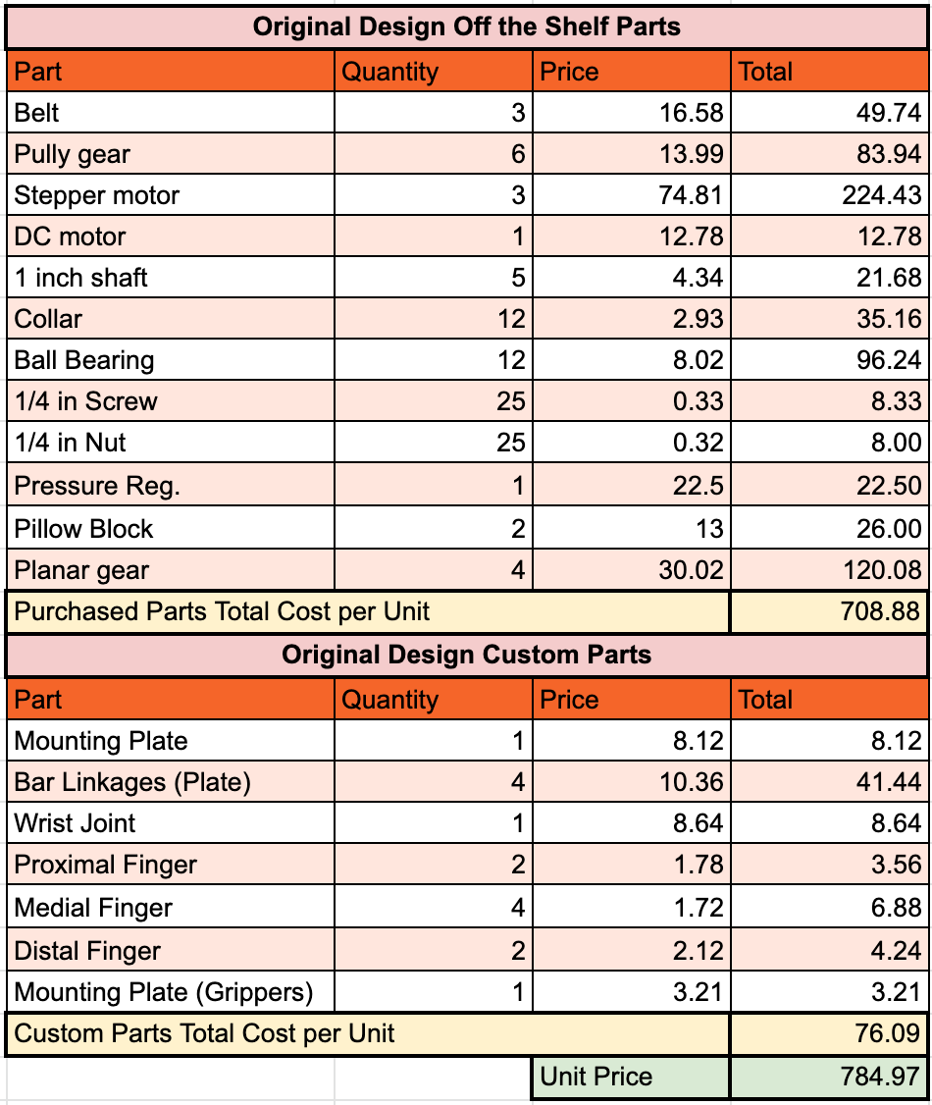
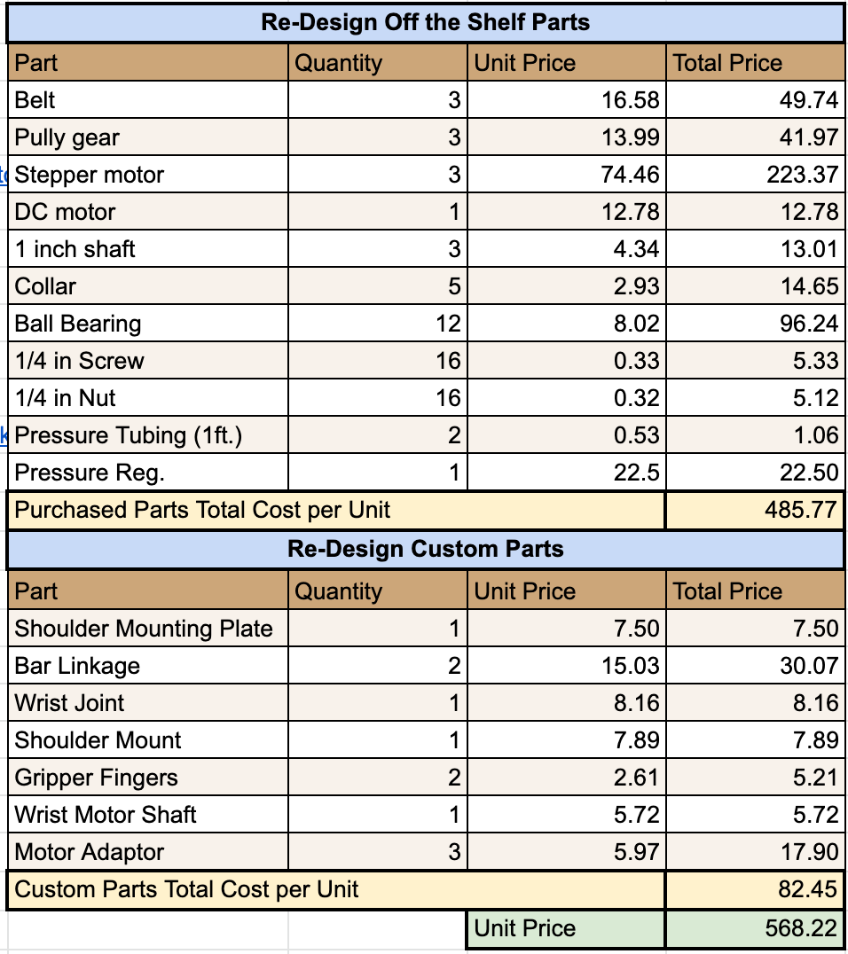
Appendix Economic Analysis

